Slide 1
“ IT Help Desk ”
Project By – Harshdeep Marathe.
36 ( MCA )
Under Guide – Prof. Kumar Pawar.

Slide 2
About Project
IT Helpdesk allows managing support services more efficiently by treating each and every incoming request as a unique traceable ticket.
Get support requests sent by users into a help desk solution that both empowers support agents and reassures end-users of quick, efficient and quality support.

Slide 3
Module Hierarchy Diagram

Slide 4
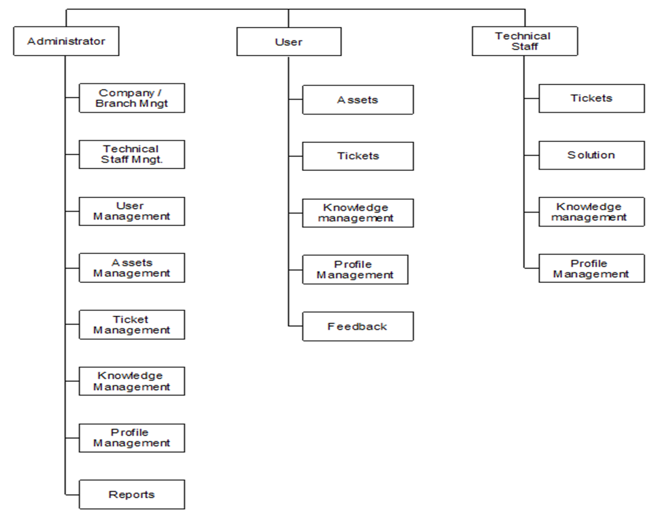

Slide 5
Use Case Diagram for Administrator

Slide 6
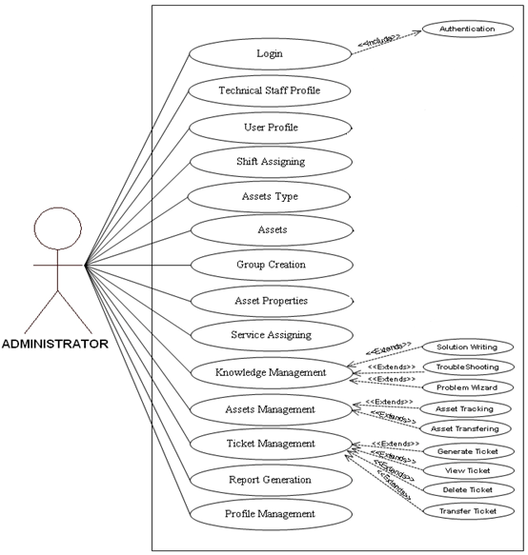

Slide 7
Use Case Diagram for User

Slide 8
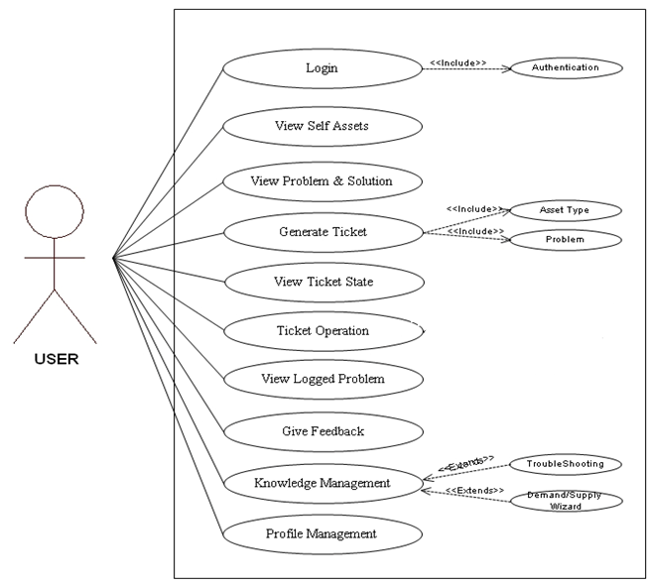

Slide 9
Use Case Diagram for Technical Staff

Slide 10
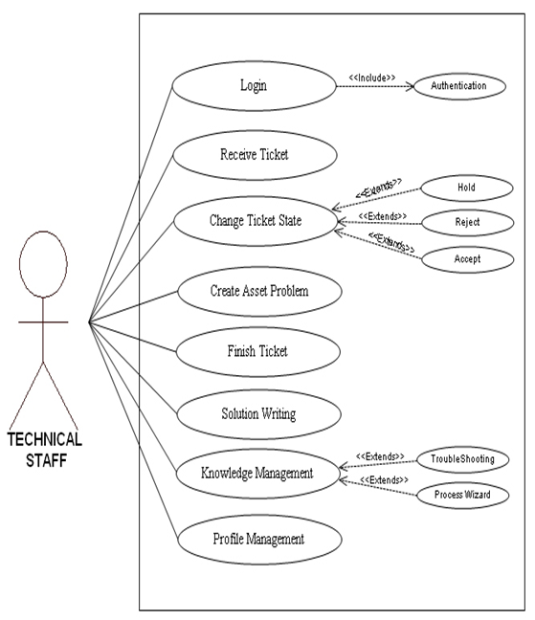

Slide 11
Sequence Diagram for Login

Slide 12
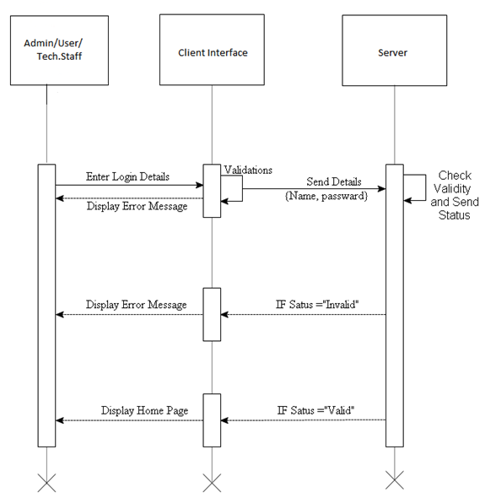

Slide 13
Sequence Diagram for Administrator

Slide 14
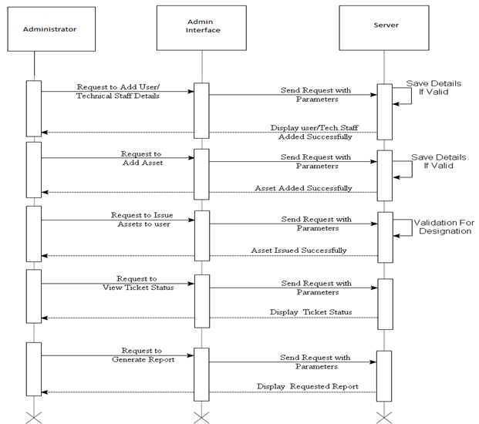

Slide 15
Sequence Diagram for Technical Staff

Slide 16
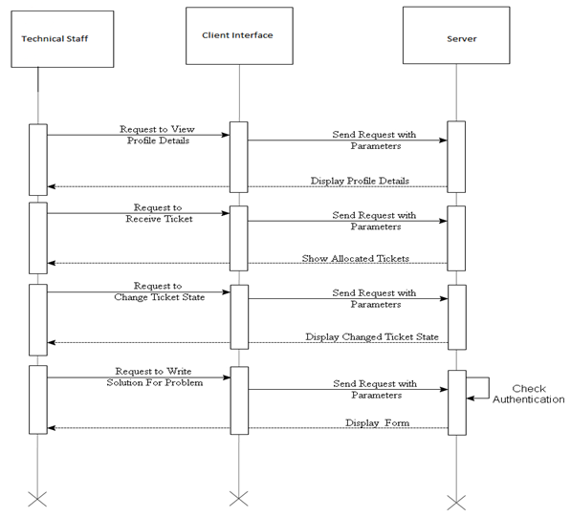

Slide 17
Sequence Diagram for user

Slide 18
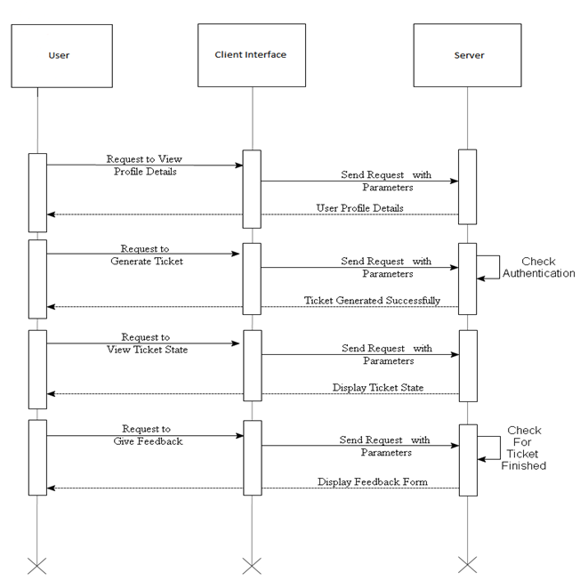

Slide 19
Activity Diagram for Login

Slide 20
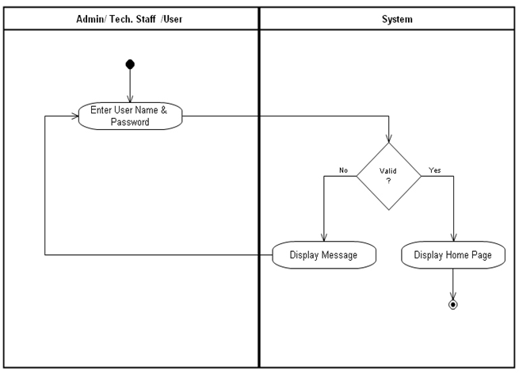

Slide 21
Activity Diagram for Add User/Technical Staff

Slide 22
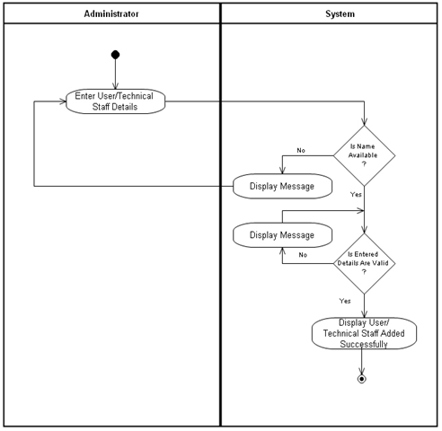

Slide 23
Activity Diagram for Issue Assets To User

Slide 24
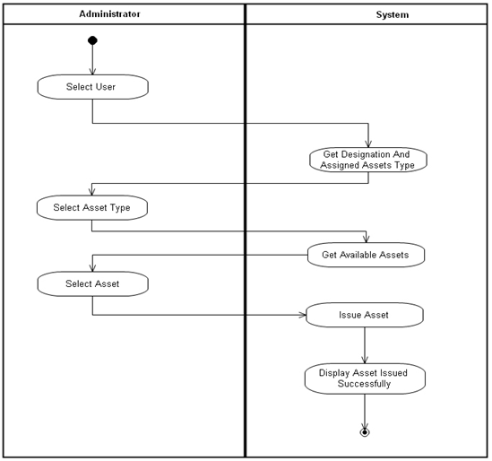

Slide 25
Activity Diagram for Ticket Generation

Slide 26
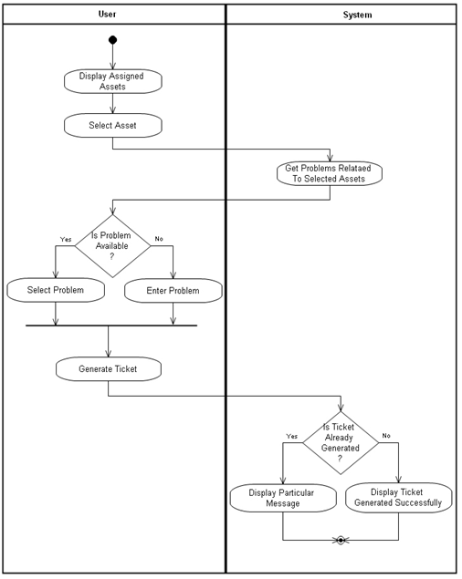

Slide 27
Activity Diagram for Ticket Solution

Slide 28
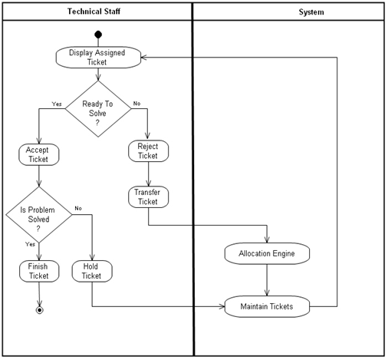

Slide 29
COMPONENT DIAGRAM

Slide 30
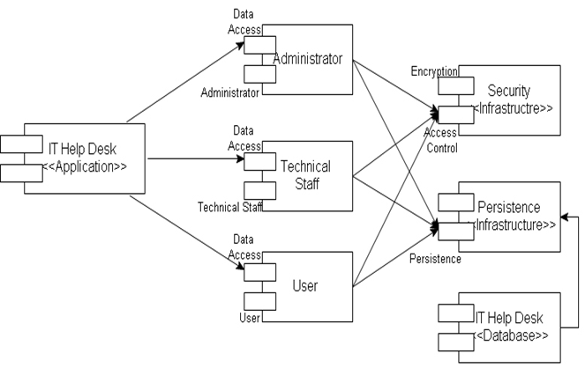

Slide 31
Entity Relationship Diagram

Slide 32
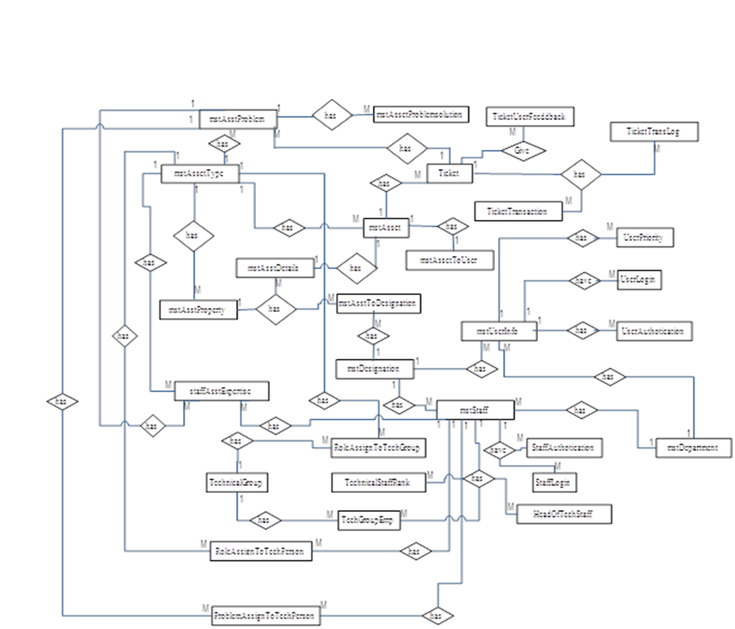

Slide 33
DEPLOYMENT DIAGRAM

Slide 34
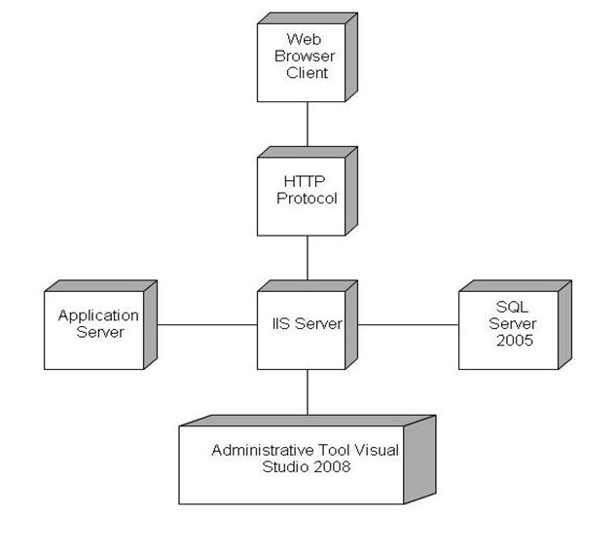

Slide 35


